Slide 1
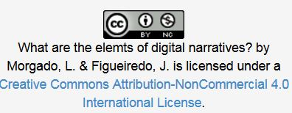
OER 4 Digital Tools for Digital Storytelling
Open Professional Collaboration
for Innovation
Universidade Aberta

Slide 2
Some Tools for Digital Storytelling
There are different features that help to build a narrative but we divide the applications in:
image, audio, text, video and the final mashup

Slide 3
Important Note
The option to use resources with Creative Commons License (CC), such as images, audio, among others is recommended.
Examples of Repositories will be presented, where it´s possible to find these resources as well examples of Open Source Tools
https://creativecommons.org

Slide 4
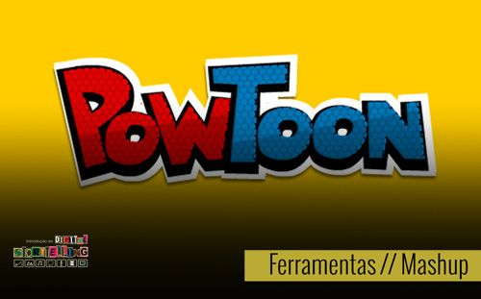
1. Powtoon
Whats is?
Is a Web 2.0 tool
https://www.powtoon.com

Slide 5
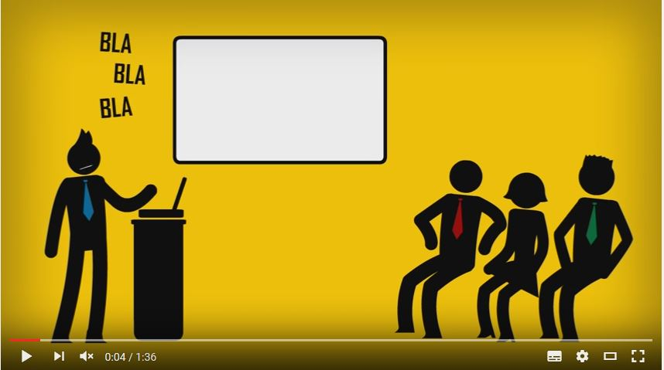
1. Powtoon
Tutorial
https://youtu.be/ldY3USp8I8g

Slide 6
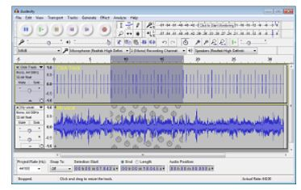
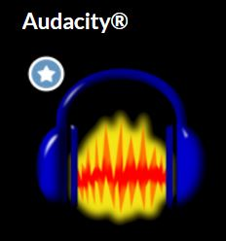
2. Audacity
http://www.audacityteam.org/

Slide 7
2. Audacity
Tutorial Audacity
http://manual.audacityteam.org/

Slide 8
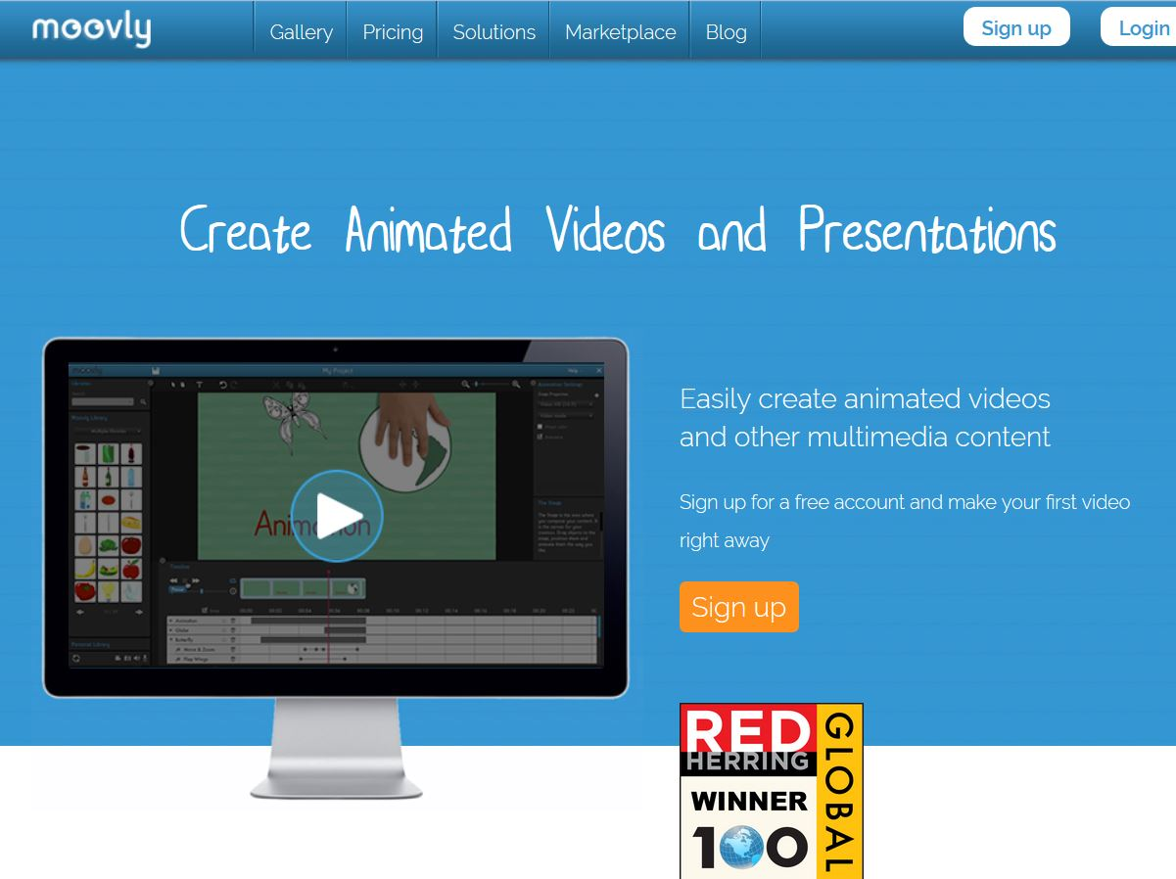
3. Moovly
https://youtu.be/MY8rsn-KQzA

Slide 9
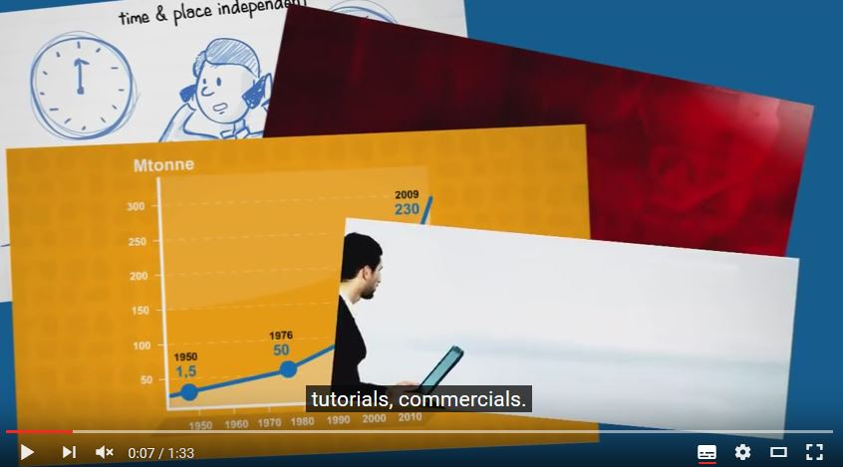
3. Moovly
Tutorial
https://youtu.be/MY8rsn-KQzA

Slide 10
Produced by Lina Morgado e José Figueiredo in the framework of Erasmus+ project “Open Professional Collaboration for Innovation”
Contributors:
This project has been funded by Erasmus + programme of the European Union. This OER reflects the views only of the authors, and the Commission cannot be held responsible for any use which may be made of the information contained therein.

