Slide 1
Licenses Guidelines for Copyright and Licencing
Open Professional Collaboration for Innovation
OpenPROF

Slide 2
.Guidelines for Copyright and Licencing
Guideline 1
Clarify who owns the copyright in works produced with the funded money
Distinction between copyright and licensing.
Institution/organization that hosts the resources (on a website, etc.) is the publisher of the materials.
There has to be clarity about who owns the copyright of the materials that authors hired by an institution/organization create in the course they teach in that institution/organization.
In most institutions/organizations the position is: intellectual property rights of work produced reside with the institution – for example: © University of London.
As copyright holder, the institution determines how to cite the work, and, for purposes of publishing resources, needs to agree to the Creative Commons license selected for the release of the work.
1

Slide 3
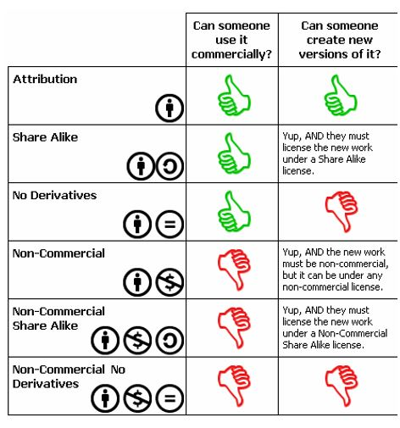
Guidelines for Copyright and Licencing
Guideline 2
Choose the most Open Creative Commons license we can
Do we wish to allow modifications of our work?
Do we wish to allow commercial uses of our work?
2

Slide 4
Guidelines for Copyright and Licencing
Guideline 3
Garantee that the OER has the necessary reference details visibly displayed
Published resources should contain the following information:
Creative Commons license with hyperlink to the license
Name of the Copyright holder and Year of Publication
Name of author(s) (N.B., this may be different from the copyright holder)
Branding of the institution/s, associates, funders etc.
Acknowledgements of those who contributed (media specialists, voiceovers, collaborators, etc.)
List of all third party copyright clearance obtained (title of resource with copyright holder – see below for more detail)
How the OER is to be cited.
General contact person – an email address for managing inquiries about the OER.
3

Slide 5
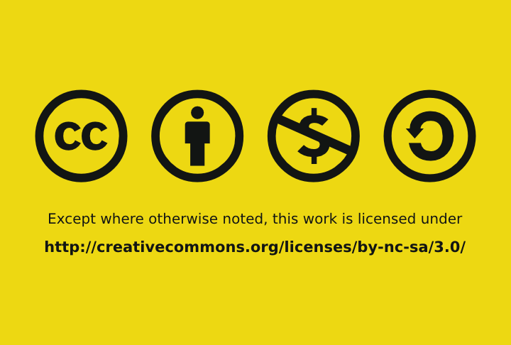
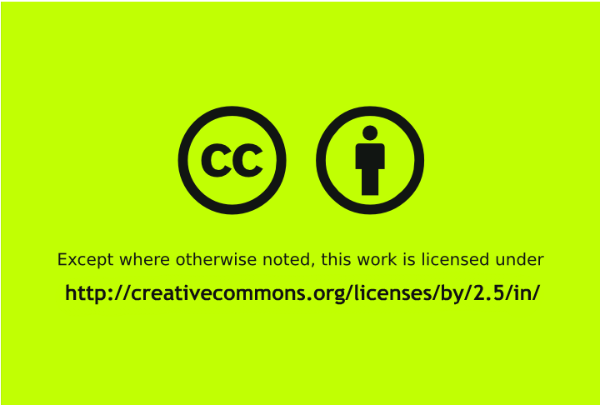
Guidelines for Copyright and Licencing
Videos
Include a ‘video bumper’ or a still picture at the beginning or end of the video (full referencing for the resource: the author, year of production, title of resource, name of faculty, name and logo of institution, CC licensing with appropriate URL etc.) Same information outlined for Word, PDF and PPT documents above. CC website .
Additional information indicating attribution such as the Institutional logo can also be added on the right hand corner throughout the video.
Include a transcript or story board of the video in either Word or PowerPoint.
http://creativecommons.org/videos/creative-commons-kiwi
http://vimeo.com/25684782
https://wiki.creativecommons.org/CC_video_bumpers
4

Slide 6
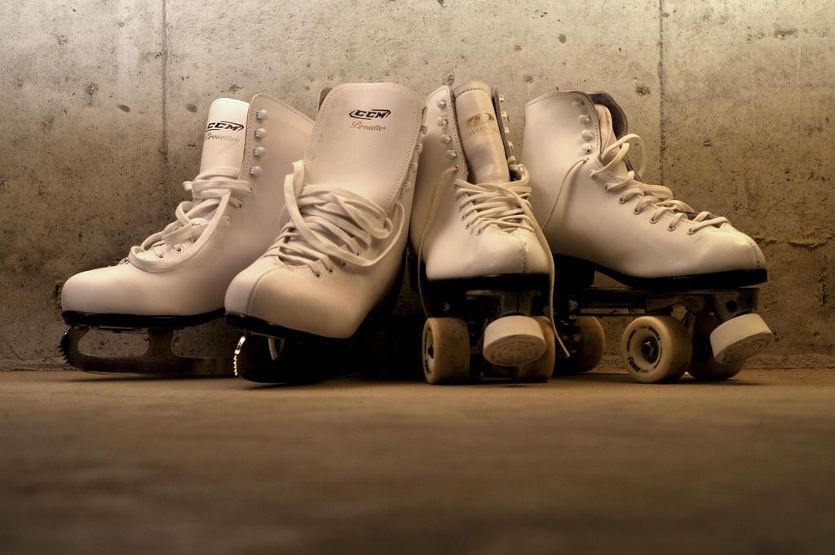
Guidelines for Copyright and Licencing
Audio
When introducing the resource, read into the script the details of attribution and licensing.
If the audio files are located on the Web the attribution and licence details with a description/link to the resource must be included.
Transcript or storyboard of the audios in either Word or PowerPoint.
Images
When introducing the resource, read into the script the details of attribution and licensing.
If the images files are located on the Internet include the attribution and licence details with a description/link to the resource.
Transcript or storyboard of the images in either Word or PowerPoint.
cc licensed (BY) flickr photo by jronaldlee:
5

Slide 7
Guidelines for Copyright and Licencing
Guideline 4
Specify how the material is to be cited when other people reuse or adapt it
Guideline 5:
Attribute correctly any content objects included in the OER that have been created by someone other than authors
Citation different from attribution
All objects (such as images found on Flickr) should be attributed correctly: you should include the author, the source, and the license.
6

Slide 8
Guidelines for Copyright and Licencing
Guideline 6
Ensure that permission has been obtained for third party copyrighted material used in the material
Guideline 7
To facilitate adaptation, use formats for text, images, video and audio that are commonly used and editable
7

Slide 9
Guidelines for Copyright and Licencing
Guideline 8
Prepare the material for uploading so as to ease downloading, remixing and discoverability
Guideline 9
When a resource is submitted for uploading, the institution/s should provide the necessary metadata – particularly title, description, and keywords
8

