Slide 1
Good and Bad design for Social Media
Open Professional Collaboration
for Innovation
FONDO FORMACIÓN EUSKADI S.L.L

Slide 2
Some rules
Be capable to distinguish a "good design " or "bad design " in social media, is important.
Some examples to demonstrate quality items: the organization, information structure, readability , ... are not functional and can not attract attention.
The choice of the examples are related with the aesthetic appearance ( colors, text, image, information overload , ... ) and not with the content message.

Slide 3
Examples of Good Design
the simplicity
the image quality
the font
the color match
the word (s) (s ) right ,
have "magic power”

Slide 4
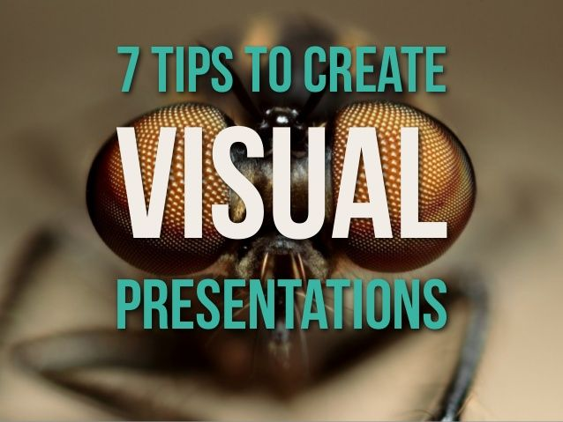
Example 1
Slide 1 in Presentation:
http://www.slideshare.net/EmilandDC/7-tips-to-create-visual-presentations

Slide 5
Example 2
Slide 1 in Presentation:
http://www.slideshare.net/jessedee/100-beautiful-slides-from-cannes-lions-2013

Slide 6
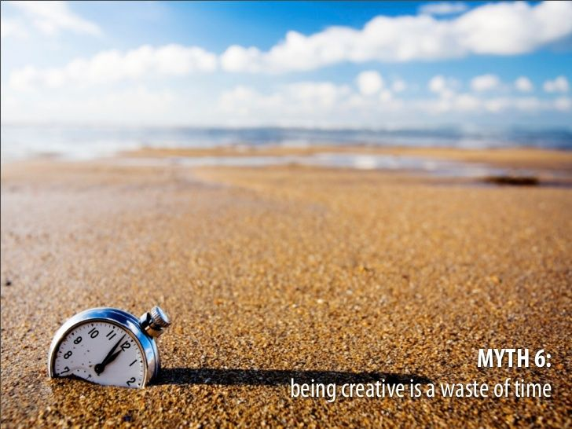
Example 3
Slide 19 in Presentation:
http://www.slideshare.net/themoleskin/visual-and-creative-thinking

Slide 7
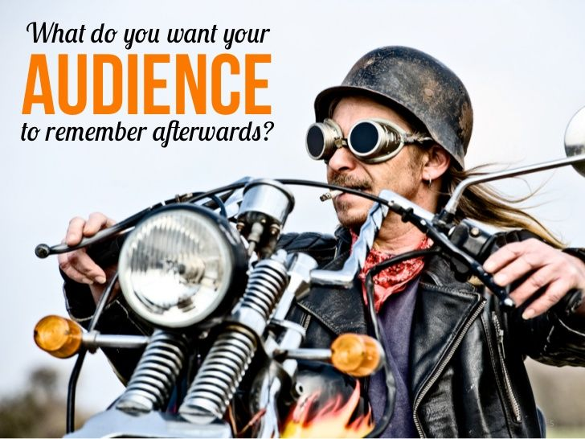
Example 4
Slide 5 in Presentation:
http://www.slideshare.net/slidesthatrock/slides-that-rock-9659045

Slide 8
Examples of Bad Design

Slide 9
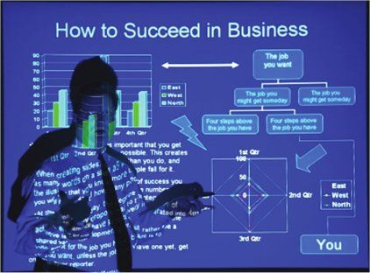
Example 5
Slide :
http://3.bp.blogspot.com/-r3Jmflon528/TYDCireq5hI/AAAAAAAAAL8/ysqL09gxk2M/s1600/
BadPresentation.jpg

Slide 10
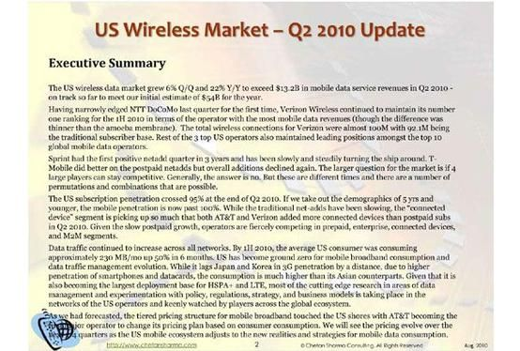
Example 6
Slide : http://cdn3.computerworlduk.com/cmsdata/slideshow/3236618/img_081810-bad-powerpoint-6_thumb555.jpg

Slide 11
Example 7
https://kmarien88.files.wordpress.com/2011/11/good-presentation.jpg

Slide 12
Example 8
http://img.docstoccdn.com/thumb/orig/2222842.png

Slide 13
Produced by OER Figueiredo & Morgado and Adapted by Zaloa Mitxelena in the framework of Erasmus+ project “Open Professional Collaboration for Innovation”
Contributors: Figueiredo & Morgado
This project has been funded by Erasmus + programme of the European Union. This OER reflects the views only of the authors, and the Commission cannot be held responsible for any use which may be made of the information contained therein.

