Slide 1
Diversity: from Stereotype to Discrimination
From Role Assignment to Discrimination

Slide 2
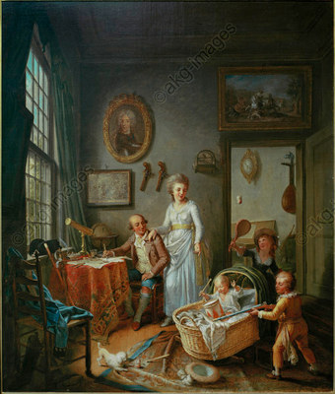
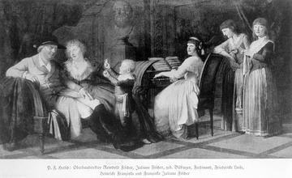
Family images from long ago Left: Philipp Friedrich von Hetsch “The Family of the Architect Fischer” 1788 Right: Wilhelm Joseph Laqy “Family Scene“ 1790

Slide 3
Ask yourself the following questions:
What was the role of the family at that time?
What is the role of the family today? What elements of diversity does the modern family display?
What characterised the father-mother-child relationship at that time?
How is it defined today?
How the relationship within a marriage at that time?
How is it today?
How could the male role be described at that time?
What roles do men/fathers play today?
How could the female role be described at that time?
What roles do women/mothers play today?
What was the relationship between men and women at that time?
What is it today?

Slide 4
Conclusion
Consider your own family or a family you know:
Do today‘s roles differ significantly from those long ago ?
Can men and women swap roles today without any difficulty?
What obstacles exist?
What disadvantages could result for the man or woman?

