Slide 1
Diversity Management and Equal Opportunities
Exclusion – Integration - Inclusion

Slide 2
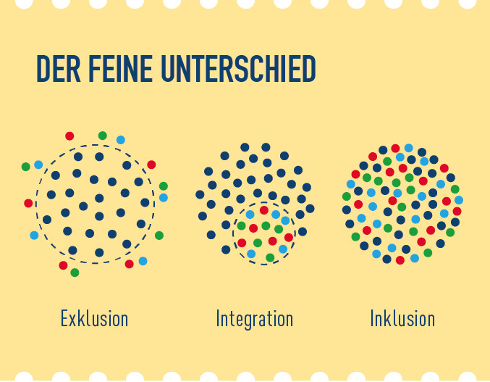
How to manage diversity within social systems Source: http://politik.metrogroup.de
(The fine difference)
(exclusion)
(integration)
(inclusion)

Slide 3
Definitions
Exclusion: shutting out people who are not members of one’s own group, erecting barriers
Example “American suburb”: perimeter fence, controlled access, entry only for members of certain social groups
Integration: the impermeable admittance of people who are not members of one’s own social group
Example “ghettos”: development of residential areas for people belonging to other groups, such as “Chinatown” and “Harlem” in New York City.
Inclusion: mixing together all different groups
Example “inclusive schools”: no separate classes or lessons for children with special needs

Slide 4
Difficulties
Disregarding general human rights
Hierarchical structures within social systems
Maintenance/creation of power structures
Exercise: discuss exclusion, integration and inclusion within the context of the provisions of the universal declaration of human rights:
www.un.org/en/universal-declaration-human-rights/

